Slide 1


PANIMALAR ENGINEERING COLLEGE Department of Computer Science & Engineering CS8811 - PROJECT WORK REVIEW DECENTRALIZED MEDICINE SUPPLY-CHAIN MANAGEMENT AND ELIMINATE COUNTERFEIT MEDICINE USING BLOCKCHAIN
GUIDE NAME: Mr.THYAGARAJAN C
BATCH.NO:C13
TEAM:SUNDARESAN R, SATHISH KUMAR T.P, VISHAL S

Slide 2
Introduction:
The main issues with drug safety in the counterfeit medicine supply chain, are to do with how the drugs are initially manufactured.
The traceability of right and active pharmaceutical ingredients during actual manufacture is a difficult process, so detecting drugs that do not contain the intended active ingredients can ultimately lead to end consumer patient harm or even death.
Blockchain’s advanced features make it capable of providing a basis for complete traceability of drugs, from manufacturer to end consumer, and the ability to identify counterfeit-drug.
The counterfeiting of medicines causes the serious threat to the society. The counterfeited medicines make an adverse effect on the health of the people and also cause revenue loss to the legitimate medicine manufacturing organizations.

Slide 3
Literature survey :
AUTHOR NAME | PAPER NAME | DESCRIPTION
U. Padmavathi and N. Rajagopalan | Concept of blockchain technology and its emergence in Blockchain Applications in IoT Security | In this paper, They implemented blockchain based apps for maintaining logs for medical devices and supplies
Ekblaw, A.; Azaria, A.; Halamka, J.D.; Lippman, A | A Case Study for Blockchain in Healthcare | MedRec is blockchain-based solution provides patients with complete access to medical information and immutable logs across providers
Kumar, T.; Ramani, V.; Ahmad, I. | Blockchain Utilization in Healthcare | In this paper, They implemented blockchain based apps for healthcare issues in more efficient ways, security and privacy aspects of data and personal information handling
Schlegel, M.; Zavolokina, L.; Schwabe, G | Blockchain Technologies from the Consumers’ Perspective | In this paper, Ubitquity is a secure platform based on blockchain technology for real-estate records-keeping that is a substitute of a legacy-based system

Slide 4
Problem Statement:
A lack of visibility into the supply chain may be the root of many challenges faced by the pharmaceutical industry. Drug shortages. Counterfeits. Medicine supply chain issues come down to differences in processes or systems. A single drug or treatment may be administered to hundreds of hospitals through distributors. it can be tough to keep track of and meet each buyer’s requirements.
Poor compliance can cost millions in penalties, incarceration for supply chain leaders, and increase the risk of harm to consumers. Poor coordination and collaboration between suppliers and supply chain networks. We have developed a Blockchain based App used to track medicine and store data in blockchain .It stores each medicine data in a block and data is encrypted in SHA-256.

Slide 5
Proposed System:
The purpose of the new system is to incorporate the features of blockchain technology and add traceability, and security to the drugs supply chain, and to provide visibility to manufacturers and drugs regulatory authority of the SUPPLY CHAIN MANAGEMENT system.
1. To Increase Trust and Transparency
2. Traceability
3. Add Visibility and Protect Privacy
4. Extended Security
5. Database for Future Statistics

Slide 6
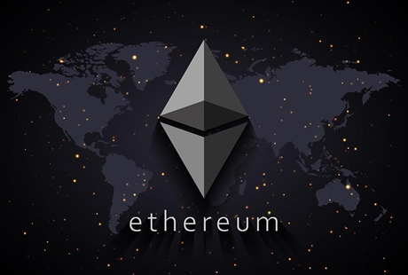
Development Environment:
Hardware Requirements:
QR code Reader
Laptop/Desktop
Software Requirements:
Blockchain - Ethereum
Language – Solidity,JS
Database – Firebase
Tools-Ganache, Lite-Server, Visual studio, Truffle ,Meta mask.

Slide 7
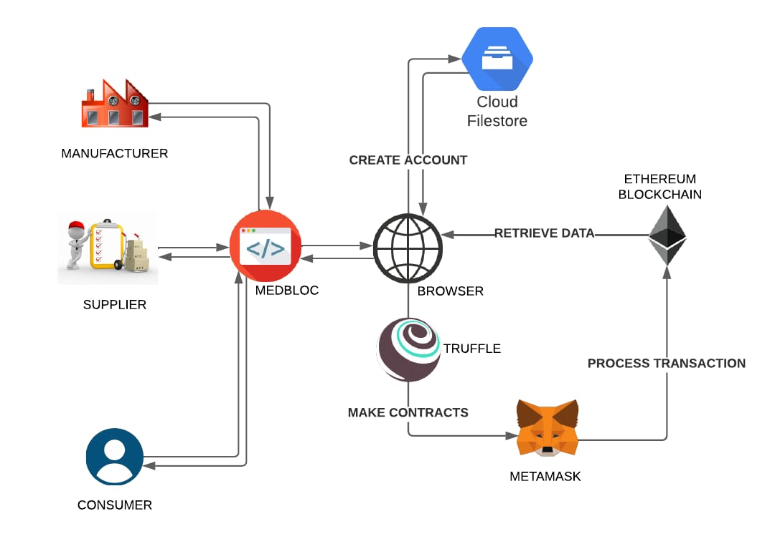
System architecture:

Slide 8
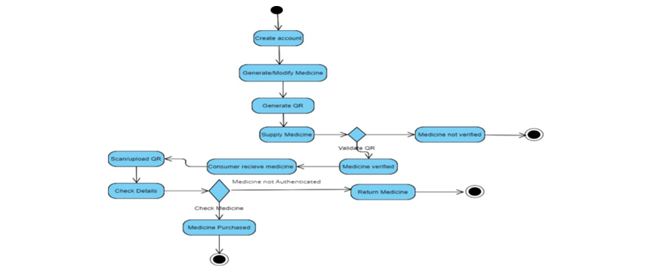
System Design Flow chart:

Slide 9
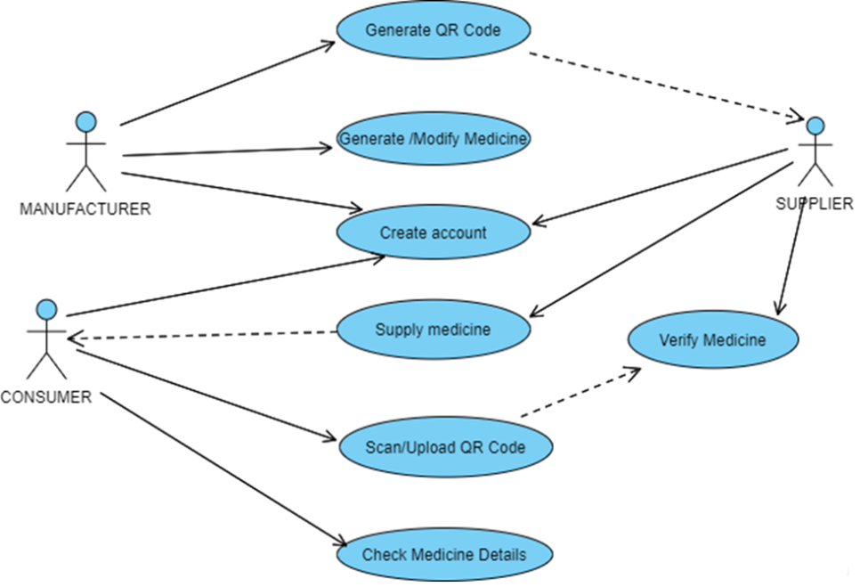
Use-case Diagram:

Slide 10
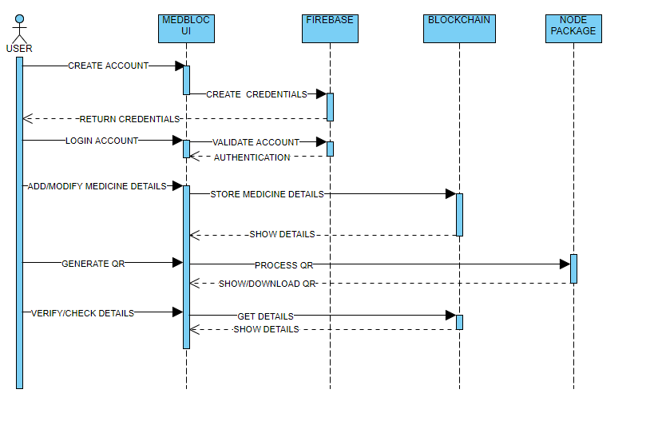
Sequence Diagram:

Slide 11
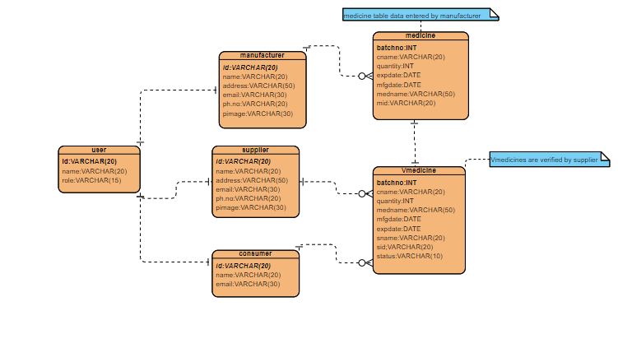
Entity Relationship Diagram:

Slide 12
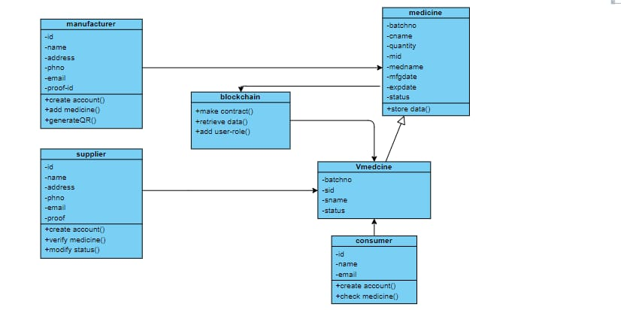
Class Diagram:

Slide 13
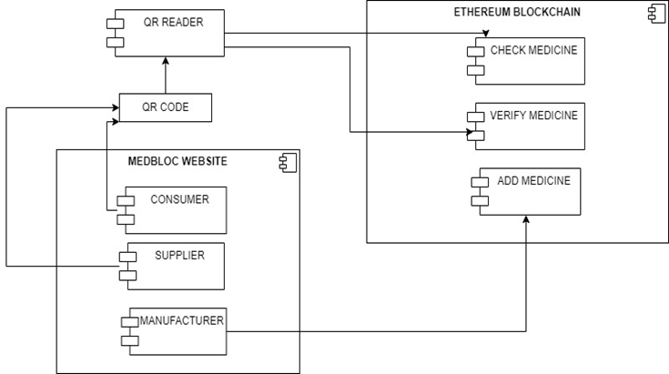
Component Diagram:

Slide 14
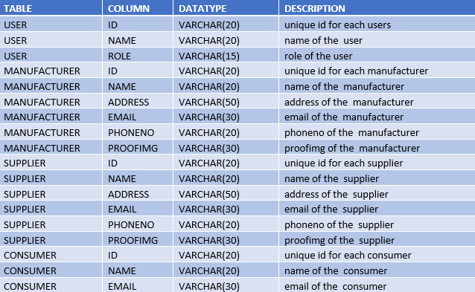
Data Dictionary:

Slide 15
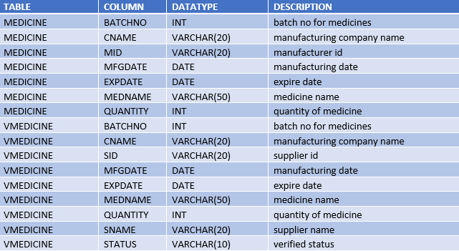

Slide 16
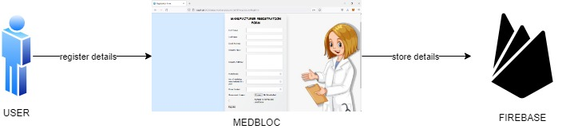
MODULE DESCRIPTION:
User Registration Details:
Manufacturer, Supplier register their details in Blockchain by giving details like Id, Name, Address, Phone NO, Email ID, Proof ID etc.

Slide 17
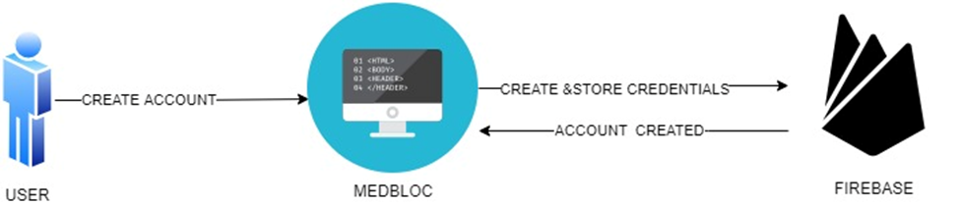
User Account Creation:
User Creates account and store user details to the blockchain like Id, Name, Address, Phone NO, Email ID, Proof ID etc.

Slide 18
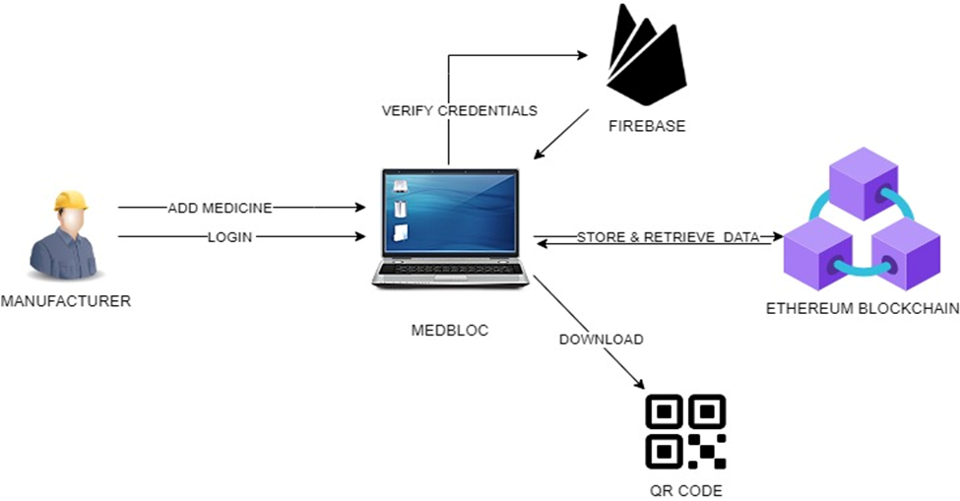
Add Medicine Details:
Manufacturer can add medicine in Blockchain by giving details like Batch NO, Company Name, Quantity, Medicine Name, Status etc.

Slide 19
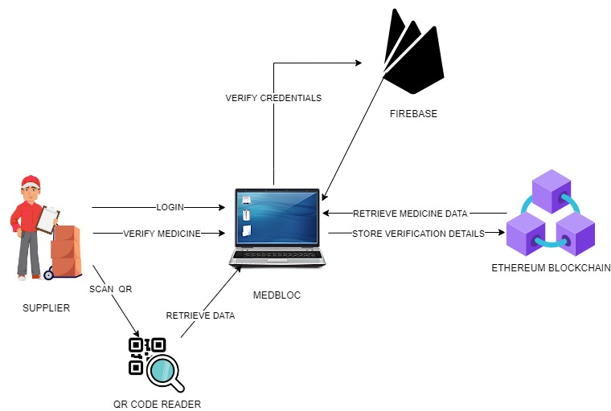
Verify Medicine Details:
In this module, Supplier verifies medicine by uploading QR code in website and once its verified stored the data in blockchain.

Slide 20
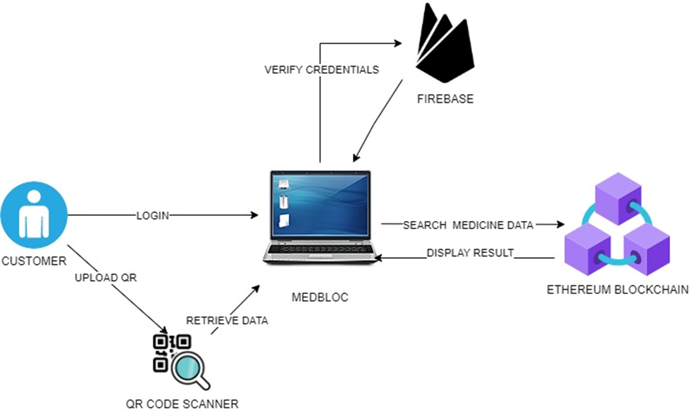
Check Medicine Details:
In this module, Once the medicine is bought from pharmacy by the user. User scans the QR code in the website and data of medicine is retrieved from the blockchain.

Slide 21
Testcases And Results:
S.No | Test Cases | Expected Output | Actual Output | Status
1. | User registering in the Medbloc application by giving User registration details | It Should Display User Account Created successfully | It displays User Account Created successfully | PASS
2. | User attempt to Login by giving user Credentials in the Medbloc Application | It Should fetch & display user home page with user details | It displays user home page with user details successfully | PASS
3. | Add Medicine details in the manufacturer page | It should display product is created successfully | It displays the product is created successfully | PASS
4. | Generate QR code for the stored medicine details | It should display the QR code generated successfully | It displays the QR code generated successfully | PASS
5. | Get medicine details by reading the QR code by Consumer | It should display the medicine details of product | It displays the medicine details of product | PASS
6. | Verify the medicine details of the uploaded QR code | It should display the medicine details verified successfully | It displays the medicine details verified successfully | PASS

Slide 22
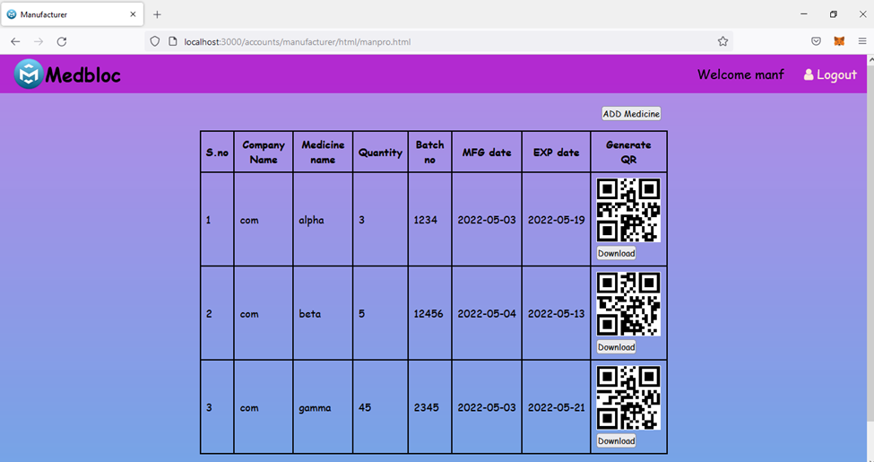
Screenshot:
Screenshot of manufacturer entered medicine details in blockchain

Slide 23
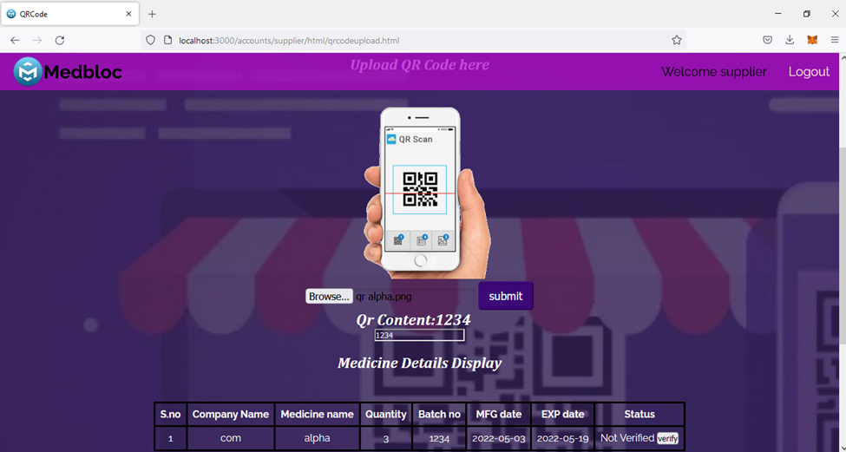
Screenshot:
Screenshot of supplier page before verify medicine

Slide 24
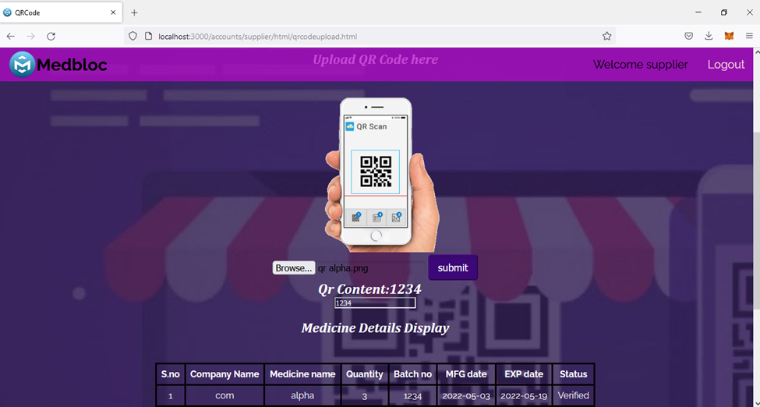
Screenshot:
Screenshot of supplier page after verification

Slide 25
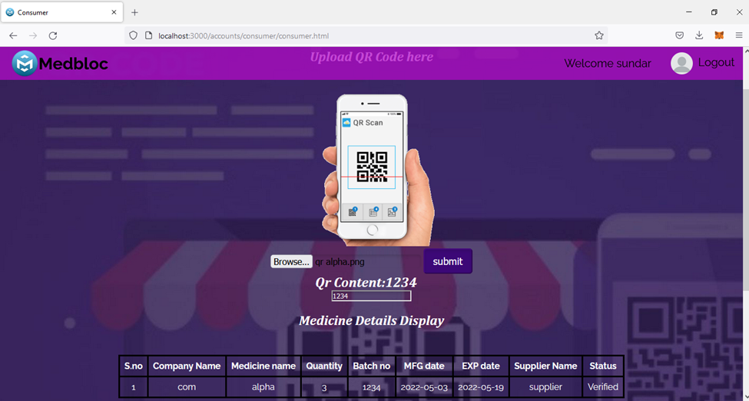
Screenshot:
Screenshot of consumer page to check a medicine

Slide 26
Conclusion:
Thus, this project has many advantages and provides a scope of improvement in the future product supply chain field.
The manufacturer and customers being able to track pharmaceutical products throughout the supply chain, they will trust each other is the main objective of the project.
There is also a scope extending of the present idea in Healthcare, E-commerce and other activities that needs Automated Decentralized Application management system.

Slide 27
Future Enhancement:
The Medbloc application is a single platform web application. we can create Android application for Medbloc and integrated different platform users together and improve accessibility
We can implement Medbloc for other blockchain applications.
We can implement decentralized application into larger and diverse platforms.
We can change to a different blockchain which offers cheaper gas price.
Decentralized application can be implemented in healthcare, Banking, E-commerce and other area which required more transparency and high security.

Slide 28
References:
[1] U. Padmavathi and N. Rajagopalan, ‘‘Concept of blockchain technology and its emergence,’’ in Blockchain Applications in IoT Security. Hershey, PA, USA: IGI Global, 2021.
[2]Ekblaw, A.; Azaria, A.; Halamka, J.D.; Lippman, A. A Case Study for Blockchain in Healthcare: “MedRec” prototype for electronic health records and medical research data. In Proceedings of the IEEE Open & Big Data Conference, Vienna, Austria, 22–24 August 2016.
[3]. Francisco K and Swanson D. The supply chain has no clothes: technology adoption of blockchain for supply chain transparency. Logistics 2018;
[4].Lemieux, V.L. Trusting records: Is Blockchain technology the answer? Rec. Manag. J. 2016
[5].Kumar, T.; Ramani, V.; Ahmad, I.; Braeken, A.; Harjula, E.; Ylianttila, M. Blockchain Utilization in Healthcare: Key Requirements and Challenges. In Proceedings of the 2018
[6].Medicalchain, Medicalchain Whitepaper 2.1. Tech. Rep. Medicalchain, 2018. Available online: https://medicalchain.com/Medicalchain-Whitepaper-EN.pdf (accessed on 14 March 2019).
[7].Schlegel, M.; Zavolokina, L.; Schwabe, G. Blockchain Technologies from the Consumers’ Perspective: What Is There and Why Should Who Care? In Proceedings of the 51st Hawaii International Conference on System Sciences, Hilton Waikoloa Village, HI, USA, 3–6 January 2018.

